Slide 1

Penelitian kreativitas
Oleh: Dr. George Land
Help everyone to learn faster

Slide 2
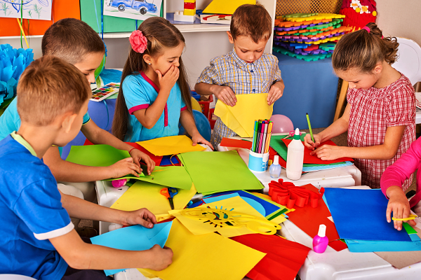
Penelitian Kreativitias Dr. Land
- perilaku kreatif dan
non-kreatif dapat dipelajari
Help everyone to learn faster

